Slide 1
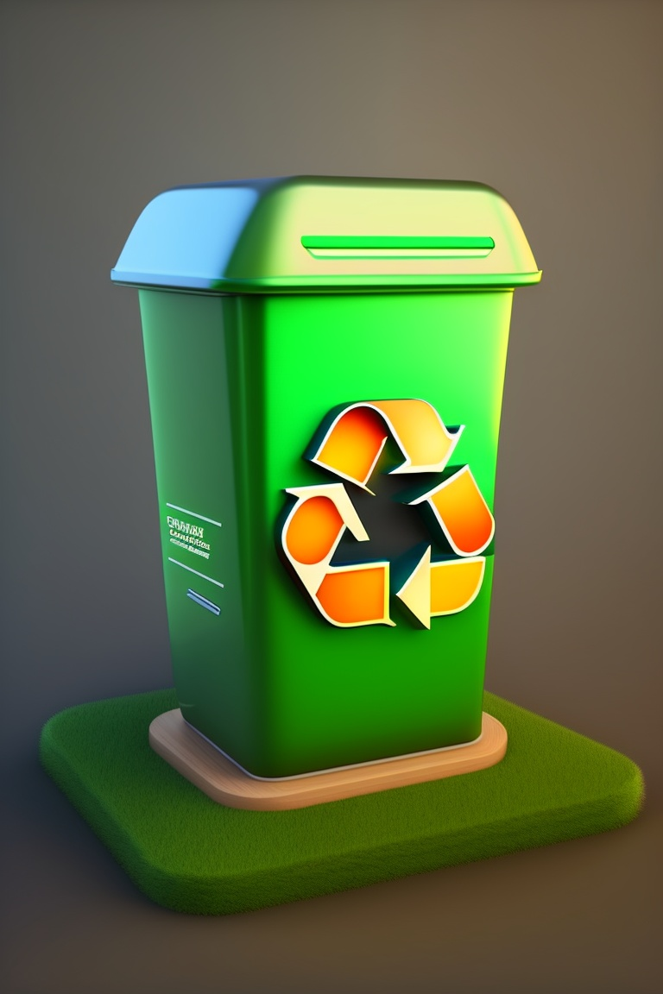
Eco
bins

Slide 2
Team details
Team name : EcoBins
College name: CUSAT, Kochi, Kerala
1 Niranjan (Team Leader)
2 Aadhil Muhammad Abou
3 Arjun K
4 Ajay PR

Slide 3
Problem statement
In a world facing increasing environmental challenges, effective waste management, sustainability practices, and community involvement have become more crucial than ever. "Ecobins: Transform, Trade, Create" is a pioneering mobile application designed to address these issues by integrating waste management, recycling, creativity, and community engagement. However, to make a more significant impact, Ecobins seeks innovative solutions to the following challenges:
1. Waste Transformation and Upcycling:
How can we enhance the content creation feature of Ecobins to encourage users to transform waste materials into artistic creations more effectively?
What strategies can be implemented to provide users with creative inspiration for upcycling and turning waste into sustainable art?
2. Eco-Conscious Marketplace:
How can we improve the user experience and functionality of the integrated auction section and marketplace for art pieces made from reclaimed materials?
What features or incentives can be introduced to encourage more users to showcase and sell their eco-conscious creations on Ecobins?
3 .Community Engagement and Education:
How can we further enhance the role of Ecobins as a community hub for reporting waste issues and offering educational content on responsible waste management?
What innovative methods or tools can be integrated to educate and engage users in sustainable practices and environmental consciousness?

Slide 4

4. Integration with Local Waste Services:
How can we strengthen the collaboration between Ecobins and local waste services to optimize waste collection routes and reduce environmental impact?
What technological solutions can facilitate real-time data exchange and coordination between Ecobins users and waste management authorities?

Slide 5
Proposed Solution for Ecobins:
Challenge 1: Waste Transformation and Upcycling
Solution 1: Creative Content Library
Develop a comprehensive library within the Ecobins app that showcases user-generated upcycling and waste-to-art projects. This library will serve as a source of inspiration for users looking to transform their waste into creative pieces. Users can browse through various project categories, view step-by-step guides, and even connect with the creators for advice and tips.
Solution 2: Gamification and Challenges
Introduce gamification elements and challenges within Ecobins to incentivize users to engage in upcycling. Users can earn points, badges, or rewards for completing eco-art challenges, such as turning a specific type of waste into a creative project. This not only encourages creativity but also fosters healthy competition among users.
Challenge 2: Eco-Conscious Marketplace
Solution 1: Curated Featured Listings
Implement a curated section within the marketplace, featuring select eco-conscious art pieces that align with current environmental and social themes. This ensures that unique and relevant items are prominently showcased, attracting more buyers and supporting artists who create meaningful eco-art.
Solution 2: Eco-Certification
Introduce an eco-certification process for art pieces listed on Ecobins' marketplace. Sellers can provide evidence of the materials used and the eco-friendliness of their creations. Certified items receive a special badge, making it easier for buyers to identify truly sustainable art pieces.

Slide 6

Challenge 3: Community Engagement and Education
Solution 1: Interactive Workshops and Webinars
Organize regular online workshops and webinars within the Ecobins app. These sessions can cover a range of topics, from upcycling techniques to responsible waste management practices. Users can participate, ask questions, and learn from experts in the field.
Solution 2: User-Generated Content Hub
Create a space within Ecobins where users can submit their educational content, such as articles, videos, and infographics, related to sustainability and waste management. A voting system allows the community to highlight the most valuable and informative content, which can then be featured prominently.
Challenge 4: Integration with Local Waste Services
Solution 1: Waste Collection Optimization
Develop a real-time route optimization system that integrates with local waste services. This system considers user-generated data on waste collection times and locations, optimizing routes for efficiency and reducing the environmental impact of collection services.
Solution 2: Waste Data Reporting
Enable users to report waste-related issues directly through the Ecobins app. These reports are sent to local waste services, creating a direct channel for community feedback and improving the responsiveness of waste management authorities.

Slide 7
Accelerating Change with Innovative Technology
1. IoT-Enabled Smart Bins: Implement IoT sensors and GPS technology to create smart bins that communicate real-time fill levels to waste collection services, optimizing collection routes.
2. AI-Powered Waste Sorting Robots: Develop robotic solutions that can efficiently sort recyclables from non-recyclables at waste processing facilities, reducing contamination.
3. Interactive Mobile App: Design an engaging mobile application for users to track their waste disposal habits, set recycling goals, and receive rewards or incentives for eco-friendly behavior.
4. Advanced Analytics Platform: Create a data analytics platform that processes Eco Bins' data to predict waste trends, optimize collection schedules, and provide actionable insights for sustainable waste management.
5. Environmental Impact Tracker: Develop a user-friendly tool within the Eco Bins ecosystem that calculates and visualizes users' environmental impact, offering tips for improvement.
By harnessing the power of innovative technology, Eco Bins aims to accelerate the positive change needed in waste management, pushing the boundaries of what is possible in sustainability and environmental conservation. Participants in this challenge have the opportunity to make a significant impact on our journey toward a cleaner, greener future.

Slide 8
Distinguishing Factors: What Sets Us Apart
Ecobins is not just another waste management solution; it represents a paradigm shift in how we view and manage waste. To fully appreciate the impact of Ecobins, it's essential to understand what sets us apart from conventional waste management approaches.
Integration of Sustainability and Creativity: Ecobins seamlessly integrates waste management with sustainability and creativity. It empowers users to not only dispose of waste responsibly but also transform it into art, turning an everyday chore into a creative endeavor.
Eco-Conscious Marketplace: Unlike traditional waste management systems, Ecobins offers an integrated auction section and marketplace dedicated to art pieces crafted from reclaimed materials. This unique platform supports a sustainable art movement and empowers users to showcase and sell their eco-conscious creations.
Community-Centric Approach: Ecobins thrives on community involvement. It serves as a hub for reporting waste issues, engaging in educational content on responsible waste management, and fostering a sense of collective responsibility for the environment.
Collaboration with Local Waste Services: Ecobins actively collaborates with local waste services to optimize waste collection routes, reducing the environmental impact of waste disposal. This collaborative spirit distinguishes us from standalone waste management apps.
Inclusive Design: Ecobins is designed with inclusivity in mind, ensuring that people from all backgrounds can easily embrace sustainability, creativity, and eco-conscious commerce. This inclusive approach sets us apart as an accessible and empowering tool.

Slide 9


Thank you!

